Slide 1

PREDICTION OF NEW LOCATIONS FOR COMMUNITY HUB AUSTRALIA
By DATAWIZ TEAM
Clarine ANSLUM
Rishab Singh Kochhar
ShaminI pUTHOOPPALLIL

Slide 2
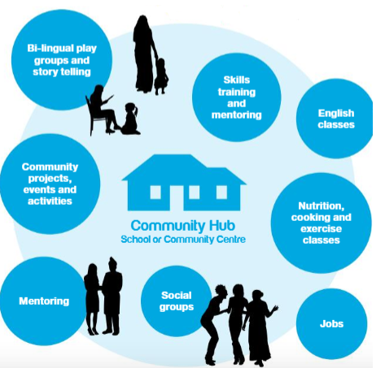
INTRODUCTION
The Community Hub Australia was established in 2015 and over 13,000 families reached annually by the hubs. There are currently 74 HUBS in Australia. Their aim is to “GROW NETWORK” as 106 Hubs in 2020.
Hubs empower people to:
Develop skills
Build local connections
Learn English
Engage in early years services and improve school readiness

Slide 3
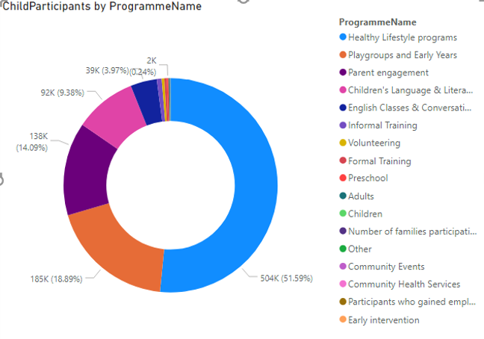
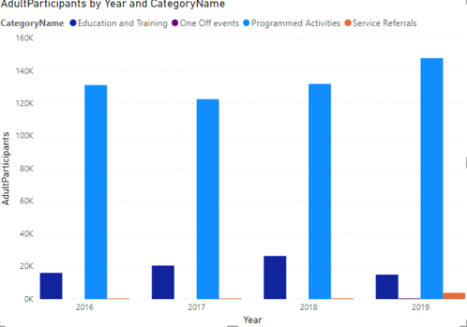
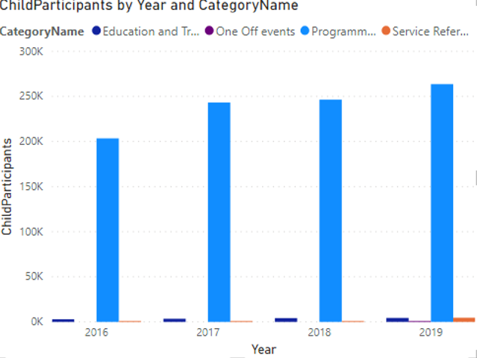
CURRENT HUBS
The participants (adults and children) through out the years from 2016 to 2019 by 74 Hubs increases
Child participants in healthy lifestyle is the most popular one
Adults and child participants in programmed activities in high demand

Slide 4


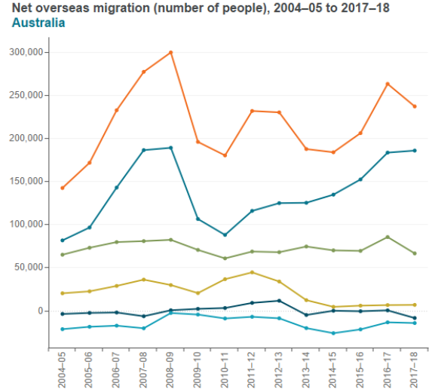


METHODOLOGY
They need new hubs to satisfy the demand of participants in future as the population increases including non English speaking background
Background
Feature Extraction
ICSEA score
School Sector
School Type
Geo location
Teaching Staff
Indigenous Enrolments (%)
Language Background Other Than English (%)
LGA

Slide 5

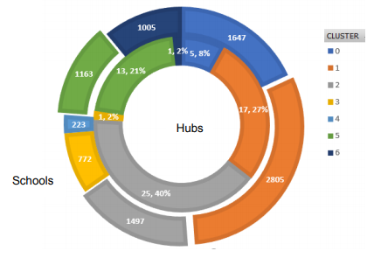
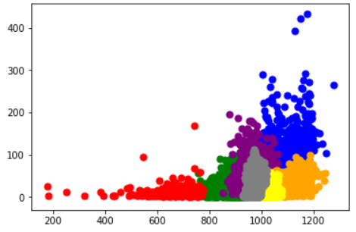
METHODOLOGY…
Machine Learning models
K-Means Clustering
Agglomerative Clustering
Cluster and Hub Existence
Visualisation of 7 Clusters

Slide 6
SELECTION CRITERIA
Remoteness = ICSEA -SEA-Percent Indigenous student enrolment
SCHOOLS | LGA
ICSEA : >800 | Kids' Development vulnerable % : >20
Geo Location : Major cities and Inner Regional | Age group (0-14) % : > 20
School sector : Government &Catholic | Single parent % : >20
School category : Primary &combined | Remoteness score : >750
State: VIC, SA, QLD, NSW
Top 10 Non English speaking community

Slide 7
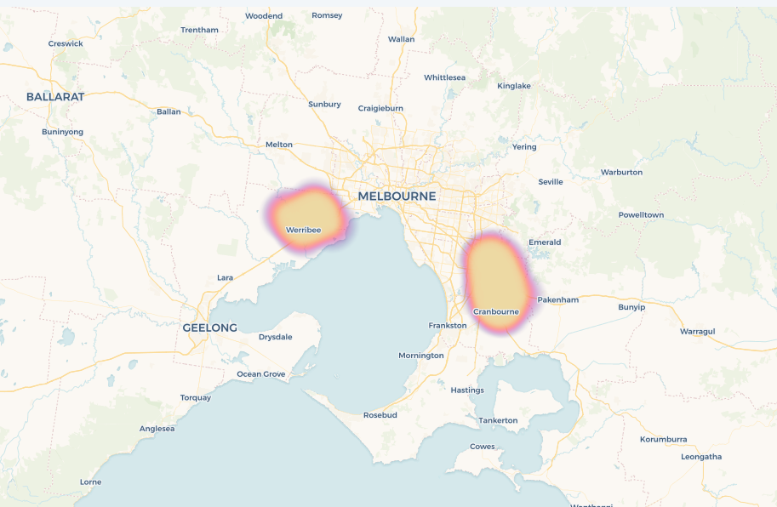
DISCUSSION AND FINDINGS
Proposed Hubs: Casey and Wyndham(LGA)
Checklist to start a new Hub
Principal/School community support
Availability of physical space at school
Funds available to pay the Hub coordinators
Wyndham
Casey
Proposed Hubs : https://shamini.carto.com/builder/257628f3-601b-42ac-a1e9-6bf480c30b34/embed

Slide 8
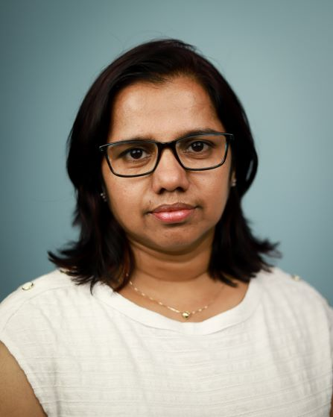
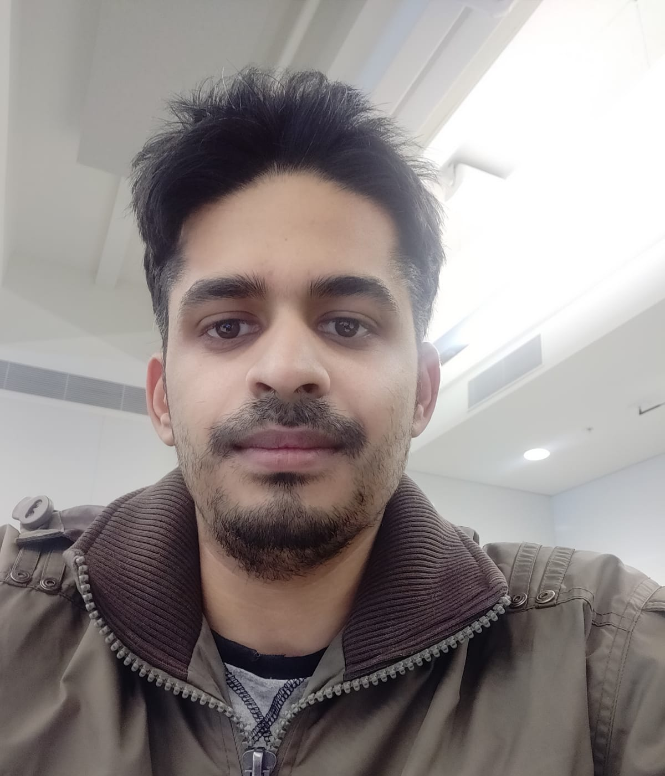
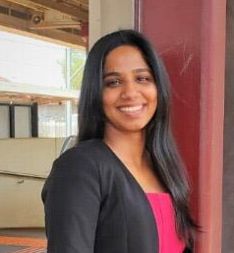

THANK YOU
Clarine Anslum
Masters In Data Science
LinkedIn
clarineanslum@gmail.com
Rishab Singh Kochhar
Masters In Data Science
LinkedIn
rishabh.kochhar404@gmail.com
Shamini Puthooppallil
Masters In Data Science
LinkedIn
shaminibaby000@gmail.com

